Slide 1



MICRO-SERVICES
Kunal Mhatre • Project Showcase
Instagram Clone
Real-time social media architecture powered by React 19, Supabase PostgreSQL, WebSockets, and Vercel Edge.
React 19
Supabase
PostgreSQL
WebSockets
Vercel
Production URL: instagram-clone-drab-pi.vercel.app

Slide 2




Why Build an Instagram Clone?
Relational Graphs
Real-Time Events
Media Optimization
Database Security
Complex follower-following mapping with instant state sync.
Sub-100ms bi-directional messaging replacing HTTP polling.
Lag-free vertical Reels rendering with viewport sensing.
PostgreSQL Row Level Security isolating private message data.

Slide 3



SYSTEM TOPOLOGY
Full-Stack Cloud Architecture
Client Layer (Frontend)
React 19 • Vite • Chakra UI • React Router v7 • Optimistic UI
SPA Client
HTTPS (PostgREST API)
WSS (PostgreSQL CDC Engine)
Backend-as-a-Service (Supabase Cloud)
PostgreSQL Relational DB • GoTrue JWT Auth • S3 Storage • Realtime WS
Cloud Engine
Edge Deployment & Hosting
Vercel Global Edge CDN • Automated CI/CD • Instant SSL Provisioning
Global CDN

Slide 4
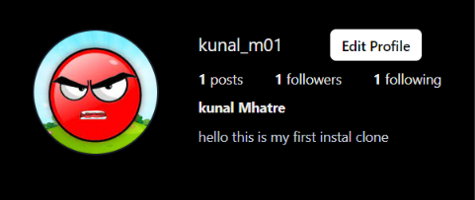
CORE FEATURE MODULE 01
Authentication & User Profiles
JWT Session Security
GoTrue cryptographic token authentication with encrypted password hashing.
Dynamic URL Routing
Deep-linkable profiles using clean custom paths formatted as /:username.
24
1,420
385
Real-Time Metric Sync
Instant live calculation of post counts, followers, and following lists.

Slide 5
CORE FEATURE MODULE 02
Newsfeed & Cloud Media Pipeline
STEP 01
STEP 02
STEP 03
STEP 04
Media Upload
Relational Join
Optimistic UI
Skeleton UX
Direct hash uploads to Supabase Storage S3 buckets.
Single query combining posts, authors, comments, and likes.
Instant double-tap like heart reactions without server latency.
Smooth Chakra UI loaders preventing cumulative layout shifts.

Slide 6

CORE FEATURE MODULE 03
Sub-Second Direct Messaging
WebSocket Subscriptions
Client hooks subscribe directly to message channel mutations.
<100ms
Instant User Discovery
Debounced search modal initiates direct conversation threads.
Message Dispatch Latency
Continuous PostgreSQL Change Data Capture via WebSockets
Auto-Scroll Threading
DOM ref anchors maintain persistent focus on newest dispatches.

Slide 7
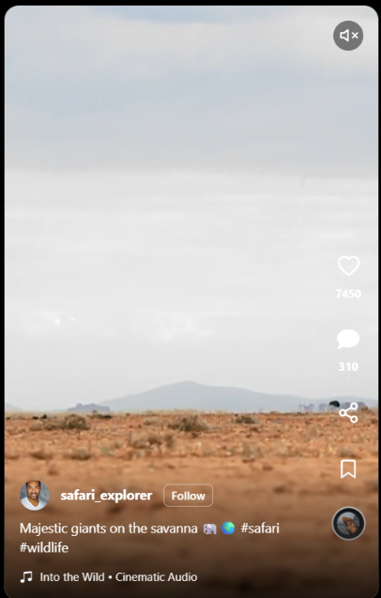
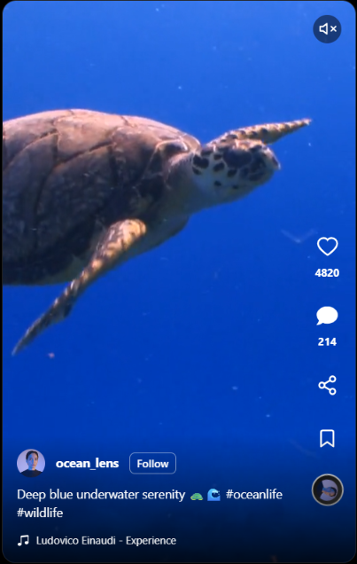
CORE FEATURE MODULE 04
High-Performance Vertical Reels Feed
CSS Mandatory Scroll-Snap
Native full-height 9:16 vertical viewport snapping with zero scroll friction.
IntersectionObserver Autoplay
Plays only when visible >50%, freezing inactive streams to protect RAM.
Interactive Playback Gestures
Tap-to-pause overlays, audio mute toggling, and rotating music marquee.

Slide 8



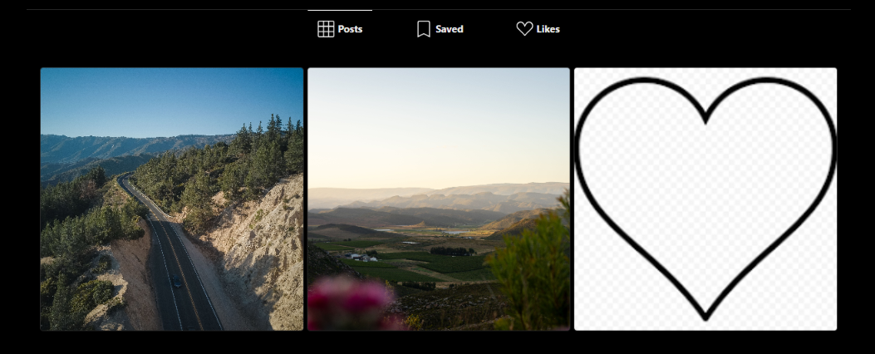
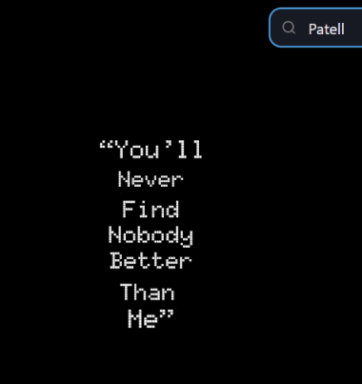

CORE FEATURE MODULE 05
Staggered Explore Grid & Live Search
Staggered Grid
Debounced Query
Hover Analytics
Signature 1x1 photo tiles mixed with 1x2 vertical video feature blocks.
Instant client-side multi-field filtering across post captions and authors.
Translucent scrim revealing like and comment metrics on cursor hover.

Slide 9
CORE FEATURE MODULE 06
Relational Follower Graph & Social Dynamics
Bi-directional Relationship Model
Suggested Users Discovery
Normalized SQL structure indexing follower_id against following_id with unique constraint safeguards.
Dynamic database filtering querying non-followed active profiles directly within the homepage sidebar.
followers: follower_id ➔ following_id
One-click follow toggle with live feed updates

Slide 10
DATA SECURITY ARCHITECTURE
PostgreSQL Schema & Row Level Security
Relation Table | Primary Schema Fields | RLS Security Enforcement
users | id, email, username, full_name, bio, avatar_url | Public read; Self-edit only
posts | id, user_id, image_url, caption, created_at | Authenticated creation
conversations | id, user1_id, user2_id, last_message, updated_at | Participants only (auth.uid check)
messages | id, conversation_id, sender_id, text, created_at | Strict conversation member isolation
Database-Engine Isolation: PostgreSQL Row Level Security enforces tenant privacy rules even if frontend clients are compromised.

Slide 11

Thank You! Open for Questions.
Full-stack social media architecture built with React 19, Supabase PostgreSQL, and real-time WebSockets.
instagram-clone-drab-pi.vercel.app
github.com/01092005kunal/Instagram-clone
Presenter: Kunal Mhatre • Ready for Live Demonstration

